Slide 1
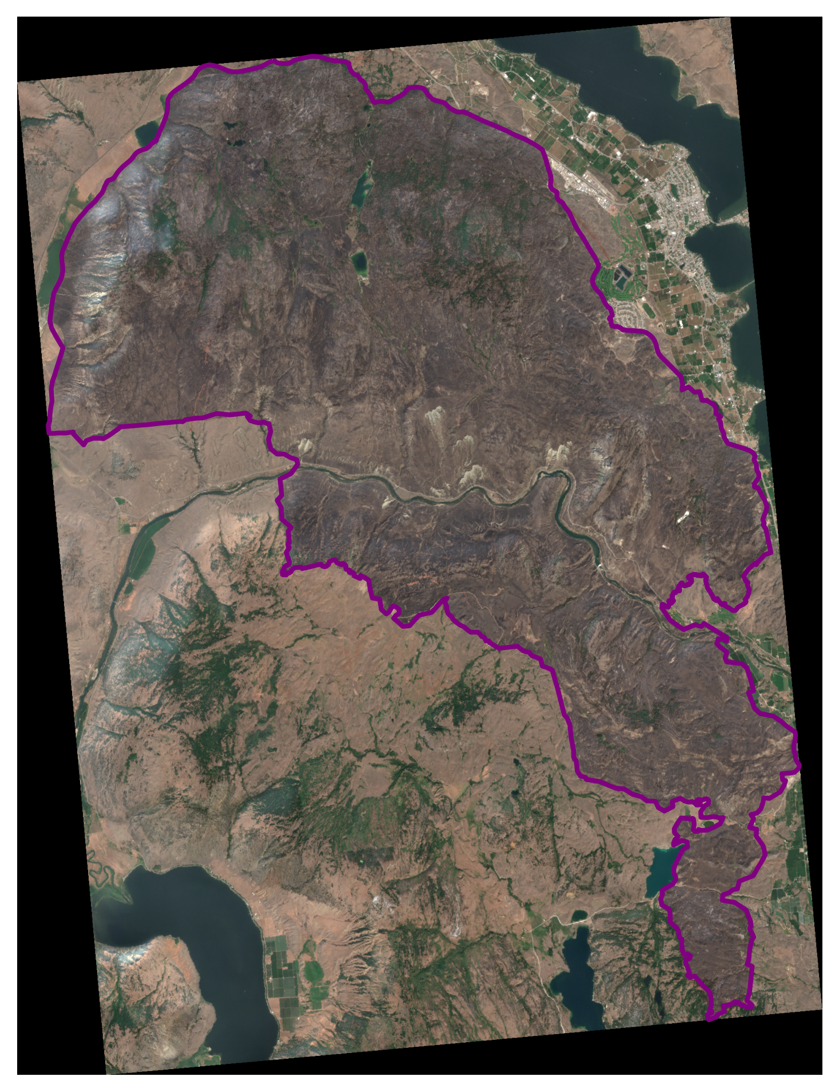
S2_2023-08-15_truecolor_post_8bit_alt

Slide 2
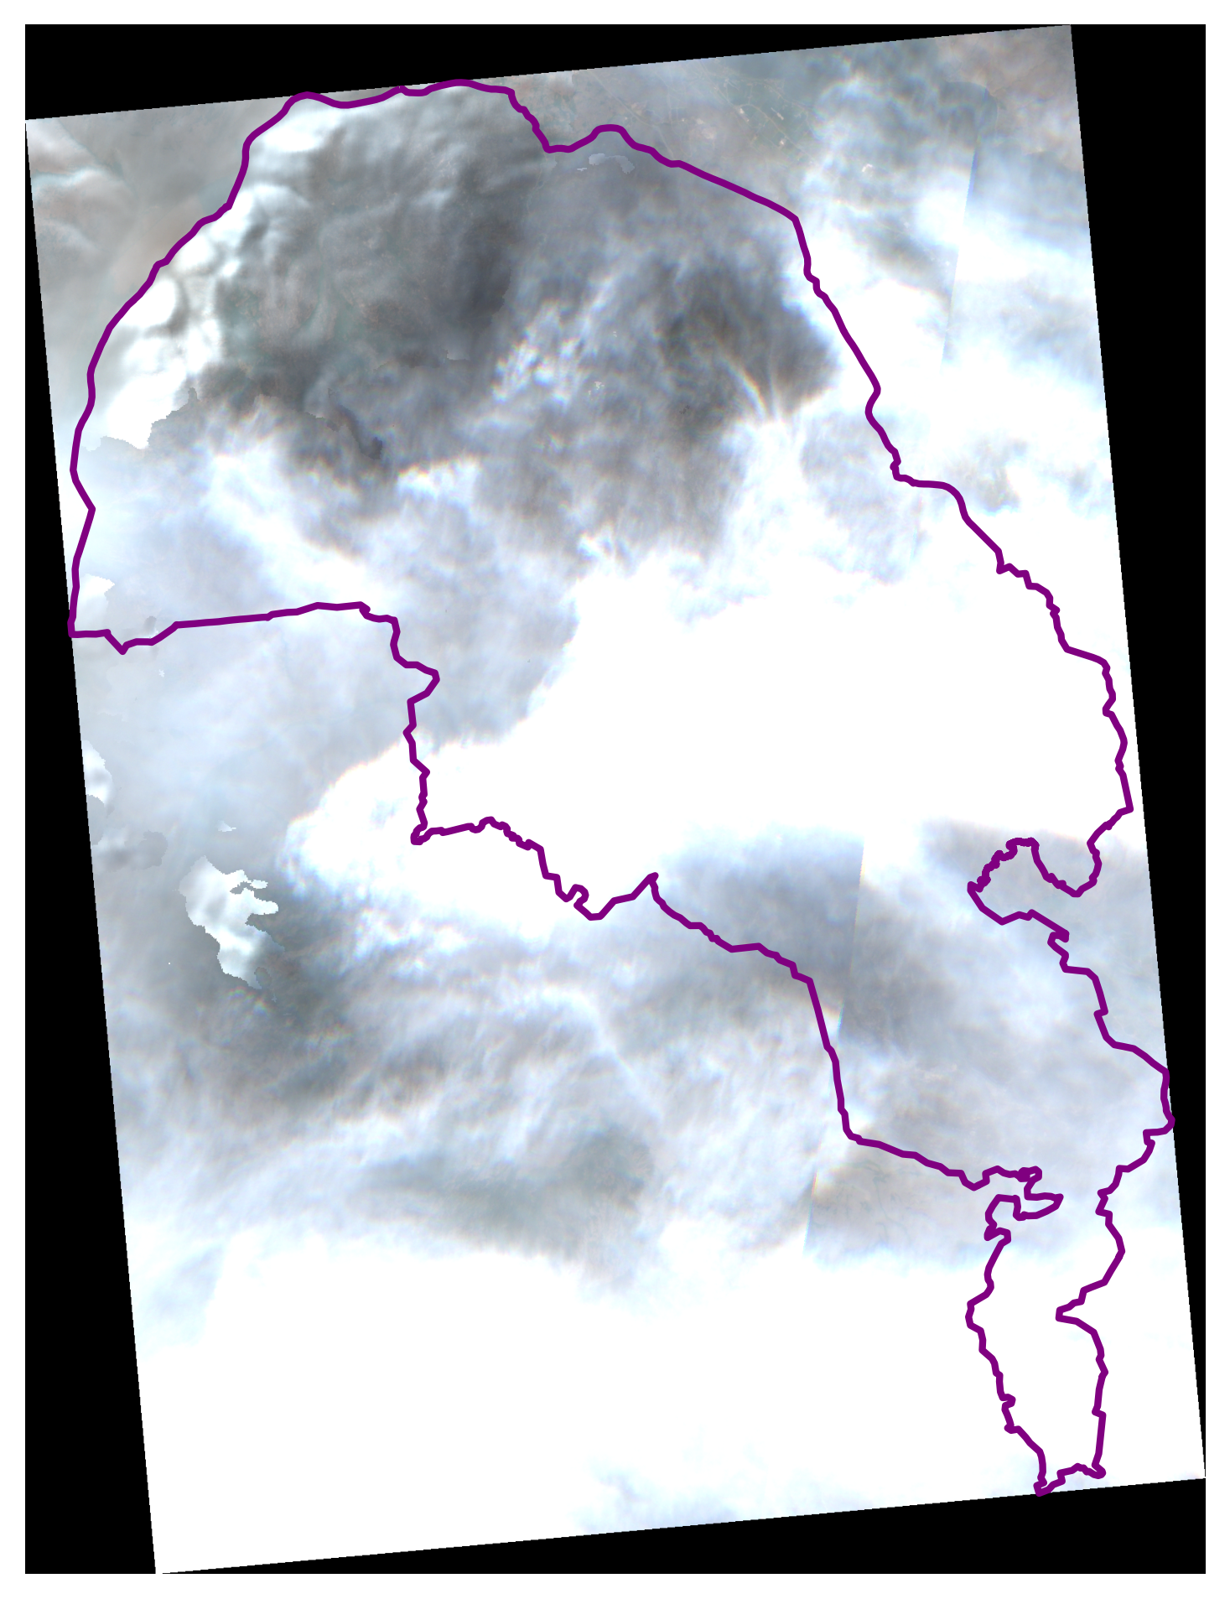
S2_2023-08-17_truecolor_post_8bit_alt

Slide 3
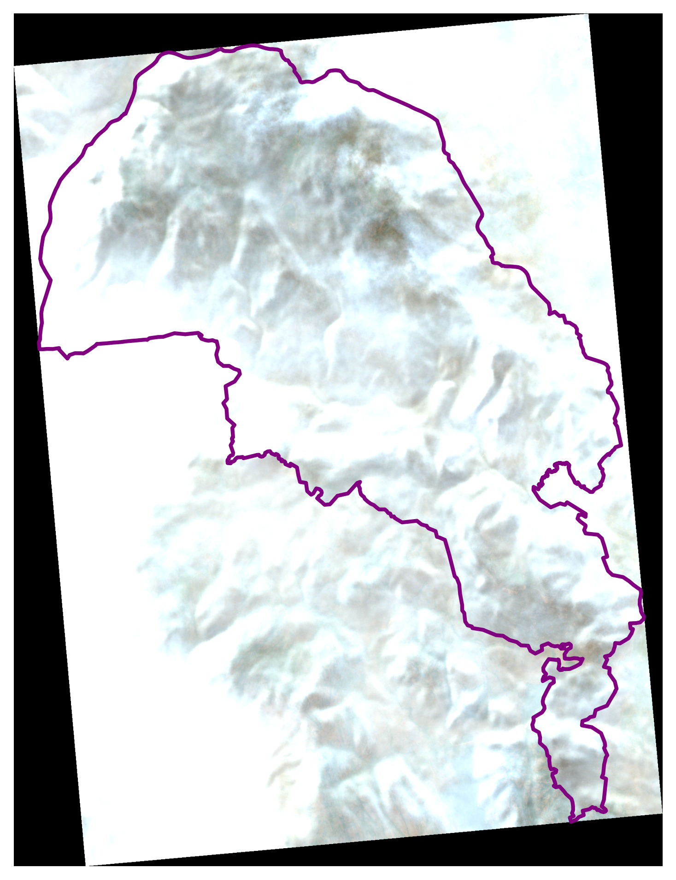
S2_2023-08-20_truecolor_post_8bit_alt

Slide 4
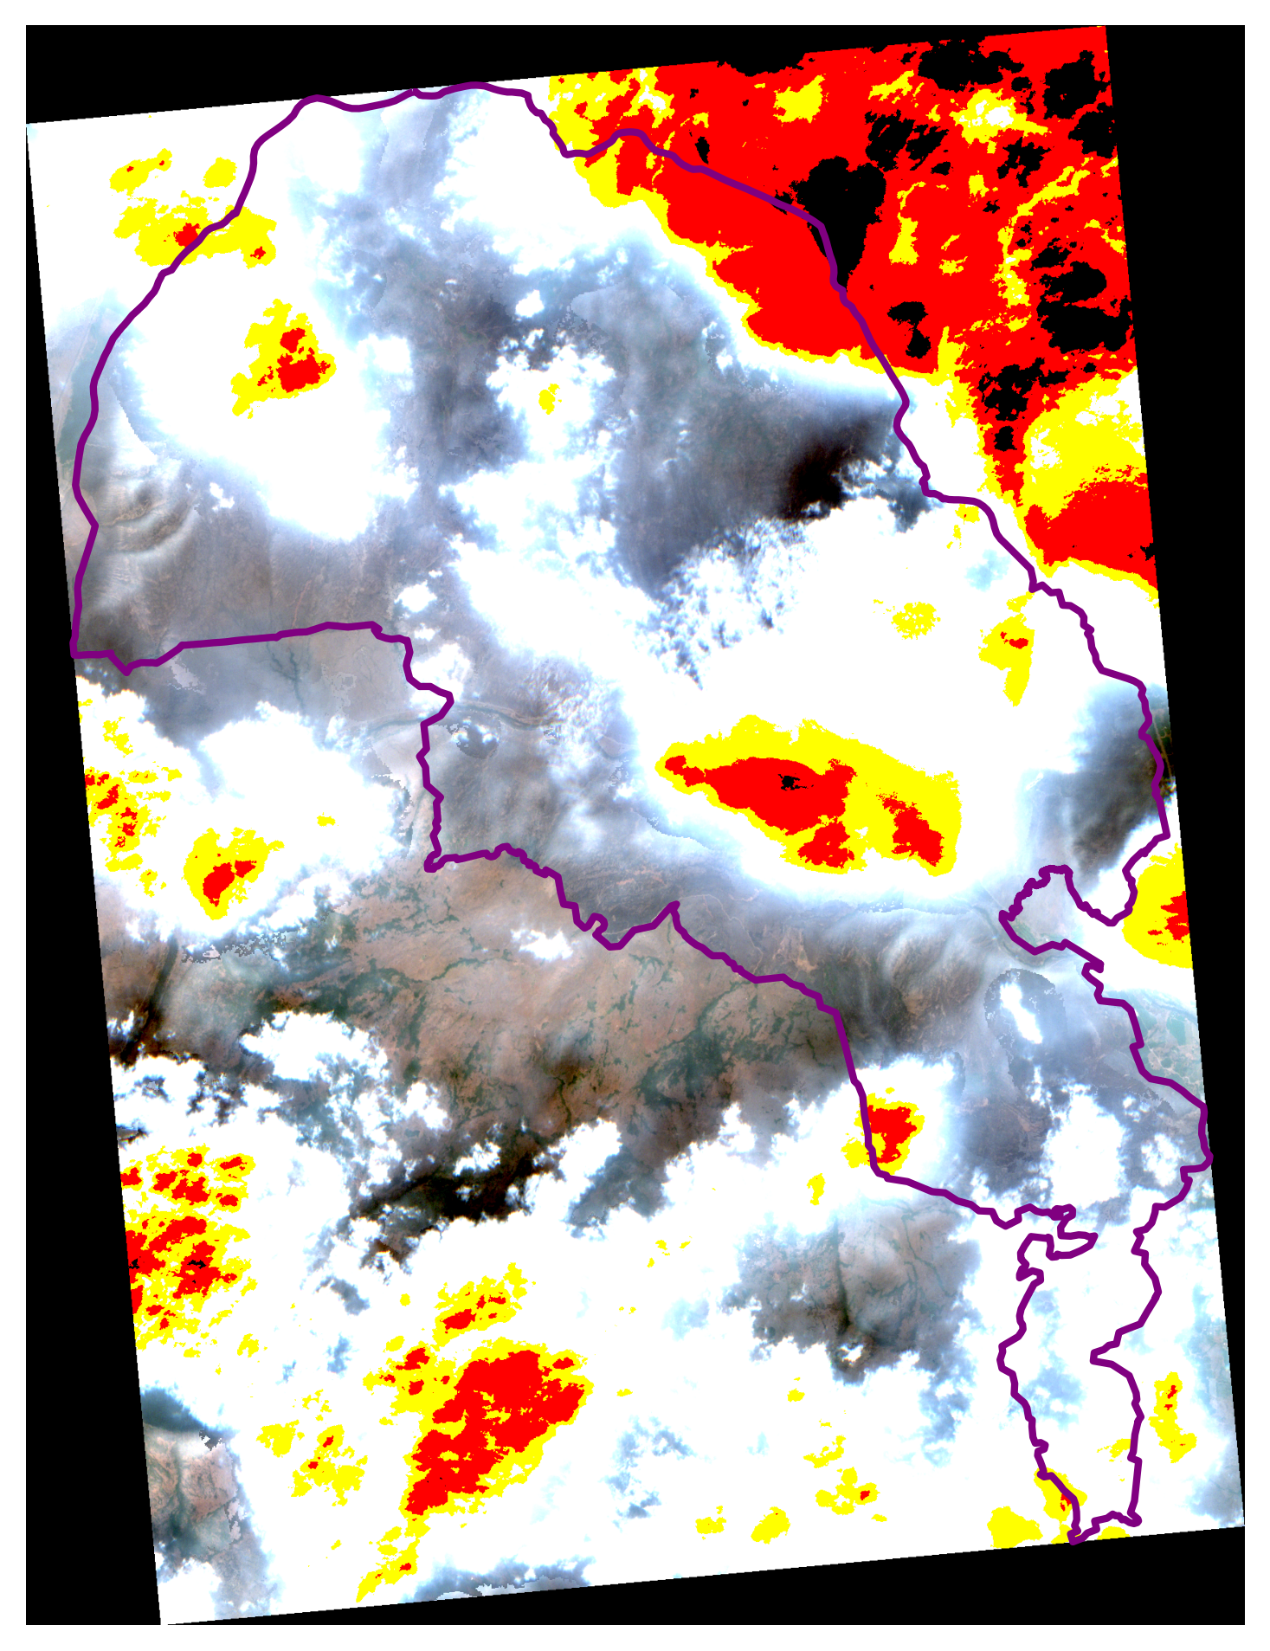
S2_2023-08-22_truecolor_post_8bit_alt

Slide 5
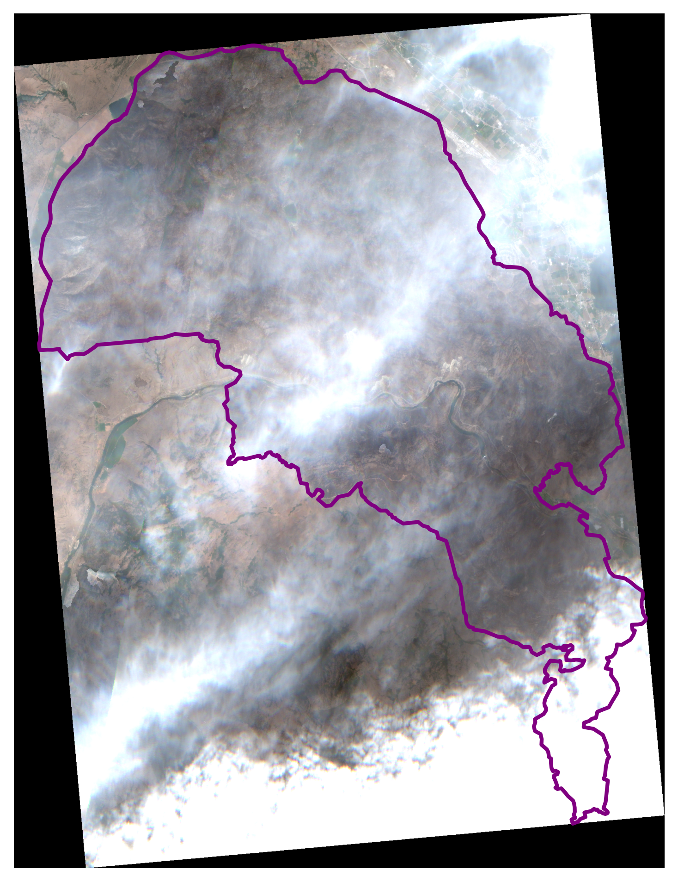
S2_2023-08-25_truecolor_post_8bit_alt

Slide 6
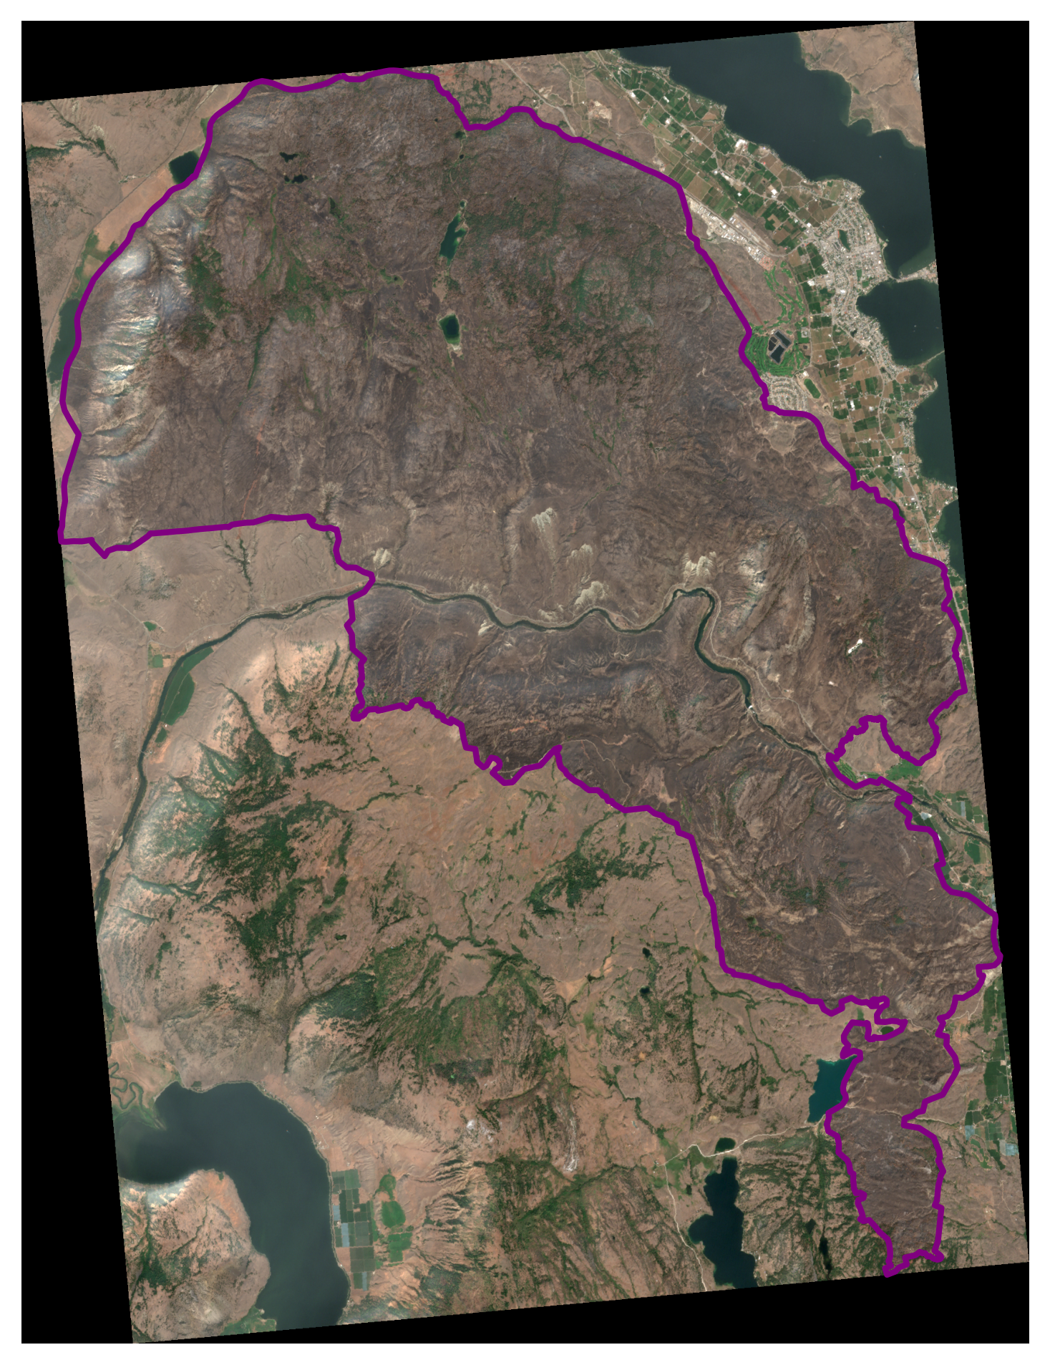
S2_2023-08-27_truecolor_post_8bit_alt

